Slide 1
Sustainability and Risk Mitigation in Your Operation
Lou Cerny
Sedlak Management Consultants

Slide 2
Sustainability and Risk Management
The biggest RISK to any company is losing profitability or competitiveness.
$
+
=
Sustainable Design
Cost
Savings
Risk Mitigation

Slide 3
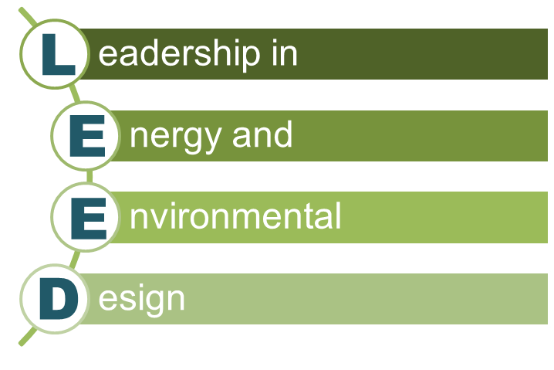
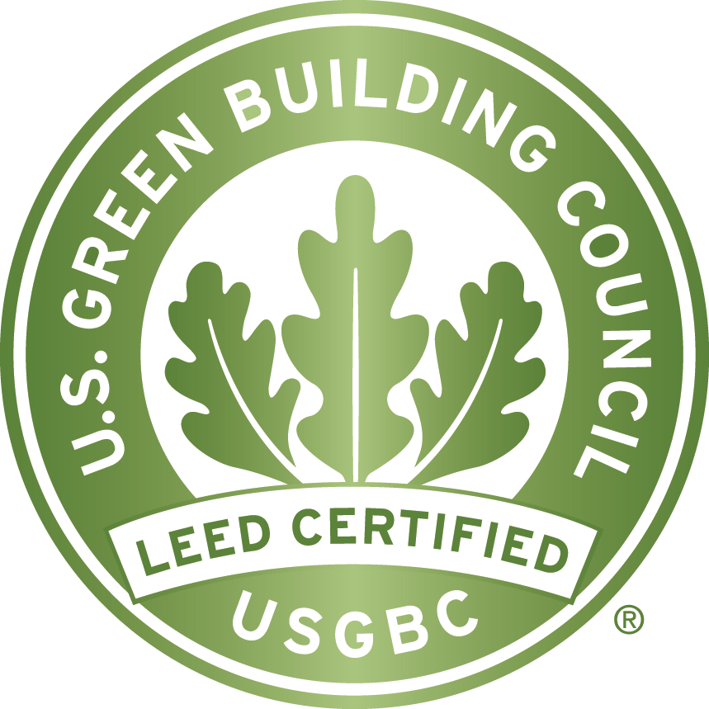
What is LEED?
Developed by the U.S. Green Building Council to set a benchmark for design, construction and
operation of high-
performance
green buildings
LEED Certification
Independent verification that a building was designed and built using strategies aimed at achieving high performance in key areas of human / environmental health:
energy efficiency
water savings
indoor environmental quality
sustainable site development
materials selection

Slide 4

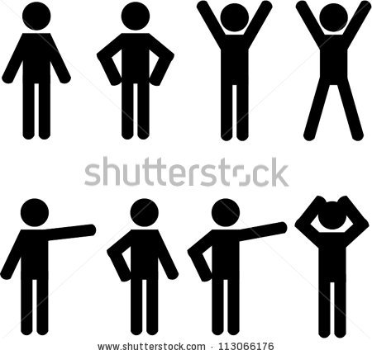
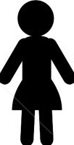
The LEED Triple Bottom Line
$$$
Profits
Enhanced brand value
New markets/products
Increased shareholder value
Reduced liability and risk
Enhanced asset management
Increased market share
Decreased supply and merchandise cost
Decreased transport costs
Decreased energy costs
People
Improved stakeholder relations
Increased productivity
Increased customer satisfaction and loyalty
Advantaged attracting new hires
Increased employee retention
Increased creativity and innovation
Increased employee motivation
Planet
Reduced waste in landfills
Reduced land and soil degradation
Reduced emissions levels
Improved responsible use of natural resources
Increased recycling
Increased reuse
Improved conservation initiatives to repair past damage
Reduced use of hazardous materials

Slide 5
“Green” Design Elements

Slide 6
Lighting

Slide 7
Shedding Some Light on Lighting
In warehouses, lighting represents:
35%
of all energy use
60%
of all electricity use
Source: U.S. EPA

Slide 8
Lighten Up Your Lighting Costs
Average cost per KWH is $1 to $4 per sq. ft. per year
Consider moving away from metal halide and HID to fluorescent T5/T8 with motion sensors:
  Savings = $.25 to $1.00 per sq. ft. per year
  Cost to replace existing lights = $.40 to $.60 per sq. ft.
  Rebates from utilities and/or tax credits may apply
  Longer bulb life
  Improved brightness
Example: 100,000 sq. ft. facility at $.50 per sq. ft. $50,000 investment
$25,000 savings 2 Year ROI
Notes:
A 400W metal halide fixture uses 454 Watts.
A replacement T5 fixture can use as low as 190 Watts.
Metal halide lamps can lose as much as 35-40% of their light output during their life span.
Fluorescent products lose only 5-6%.

Slide 9
Cost Savings Fluorescent to LED
 | Load (kW) | Incentive ($/unit) | Additional LED Cost | Annual Run Cost (365 days)
Fluorescent | 0.45 | $0 | - | $168,599
LED | 0.23 | $0 | $210,000 | $86,173
Yearly Power Savings w/LED
$82,426
$/kWh | 0.0700
Yr | Fluorescent | LED
0 | $0.00 | $210,000
1 | $168,599 | $296,345
2 | $337,198 | $382,345
3 | $505,798 | $468,518
4 | $772,841 | $554,691
5 | $941,440 | $640,864
6 | $1,160,484 | $727,037
7 | $1,329,083 | $813,210
8 | $1,596,126 | $899,383
Initial
Total Lamps | 4888
Total Ballasts | 1222
FL Ballast and lamps replaced
FL Ballast and lamps replaced

Slide 10
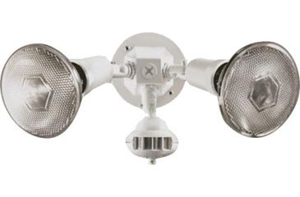
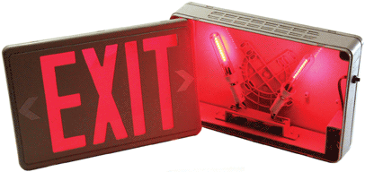
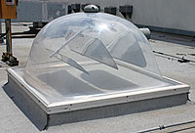
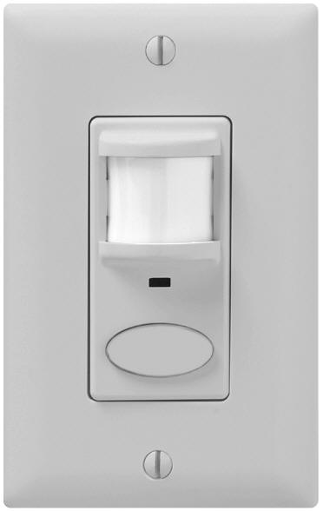
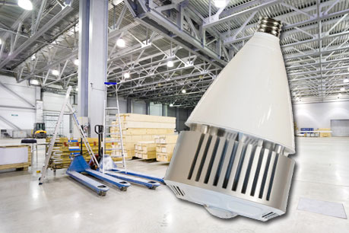
Additional Ideas for Lighting Cost Reduction
Outdoor lighting with photo sensors
LED lamps for exit signs
Occupancy sensors
Solar-tracking skylights
LED replacement for halide lamp
Notes:
LED Exit lights
Can be up to 60% cheaper to operate over ten years than standard incandescent signs
LED Direct Replacement for Halide Lamp
Direct replacement – can be user installed
No need to bypass the ballast
Instant on and instant restrike
Directional light output producing a much brighter work area
Cool running lamp to help reduce air conditioning bills
Saves 51% - 68% Energy Savings (and up to 95% when used with motion sensors)
Solar tracking skylights
Retrofit cost per unit is approx. $2,000
3-4X the hours of beneficial lighting vs. traditional skylights
Potential 2-4 year payback

Slide 11
HVAC

Slide 12
Keeping Your Cool on HVAC
In warehouses, heating, cooling and ventilation represent:
30%
refrigeration can add another
of all energy use
11%
Source: Smart Energy Design Assistance Center

Slide 13
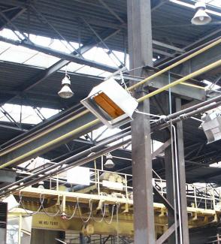
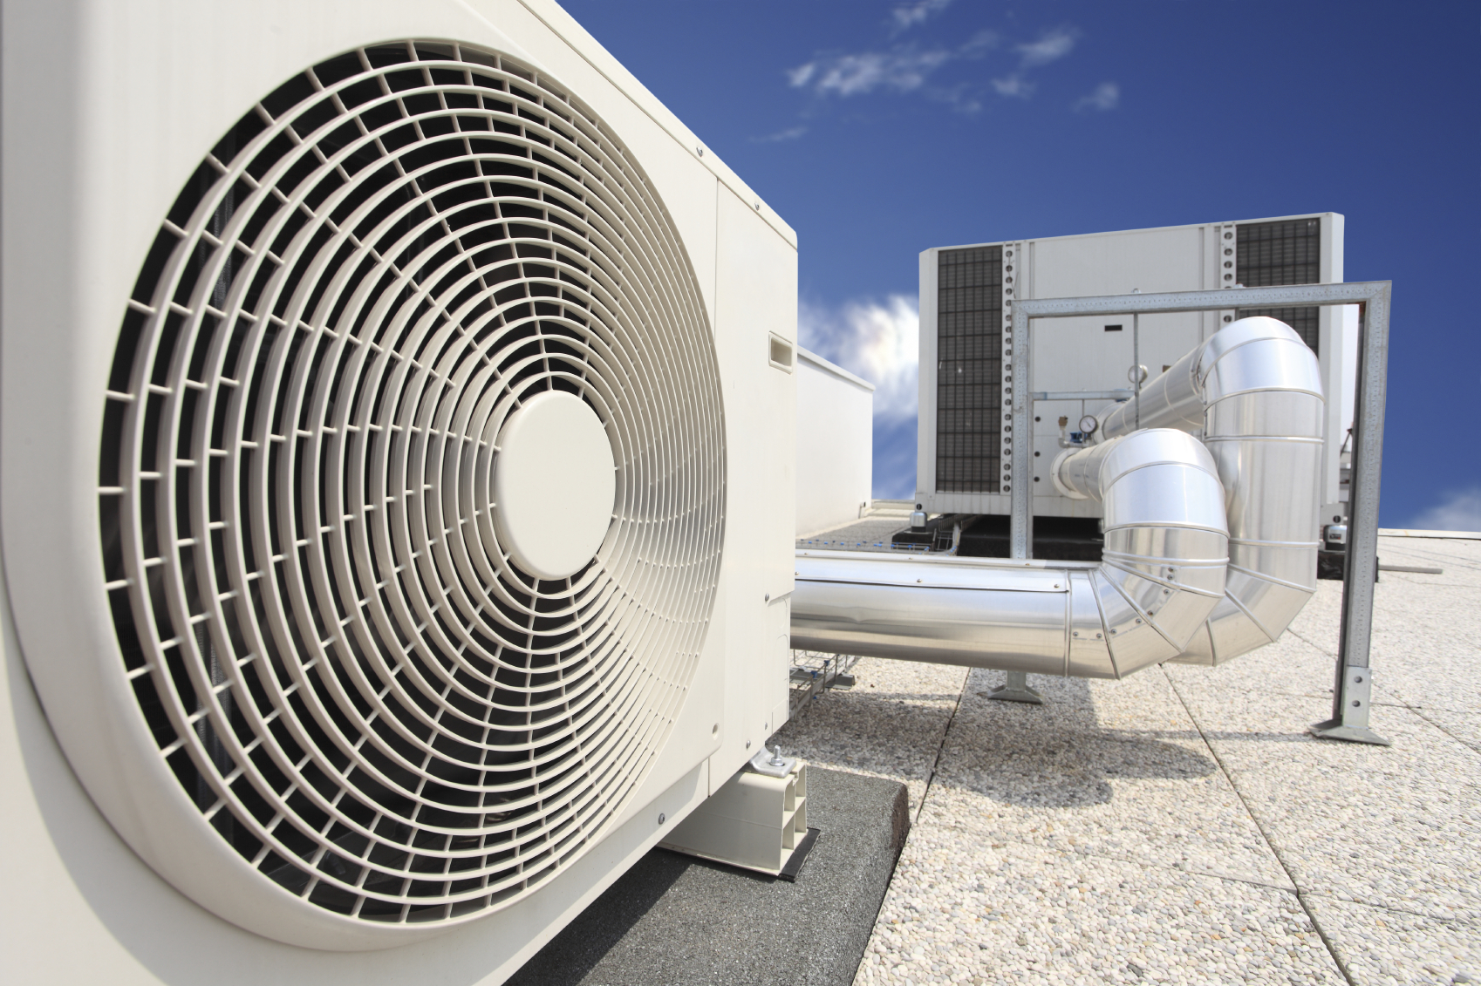
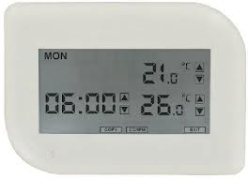
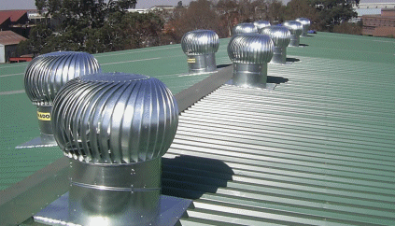
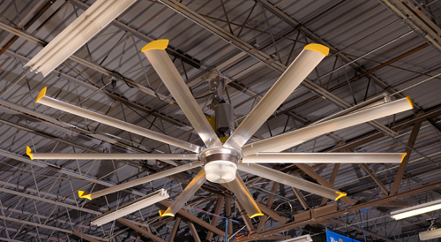
Cool Down HVAC Costs
Programmable thermostats and thermal zones
Energy efficient HVAC systems
Radiant heating
Rooftop ventilation
Air destratification
Notes:
Night flush system – Allows natural ventilation to store cool evening air for use during the summer days
Efficient furnaces and air conditioners – Choose high efficiency units and consider locating the furnace inside the building instead of on the rooftop (rooftop models only 80% efficient)
HVAC controls –Use programmable thermostats and divide building into thermal zones with separate controls
Radiant heat – Can provide heat at a 30% lower cost than forced-air systems
Air destratification – In high bay areas with heaters located near the ceiling, use ceiling fans (e.g., Big Ass Fans) or high velocity diffusers to move hot air to floor level during heating season
Natural ventilation – Use clerestory windows and skylights to allow hot air to escape in warm weather

Slide 14
Construction & Outdoor

Slide 15
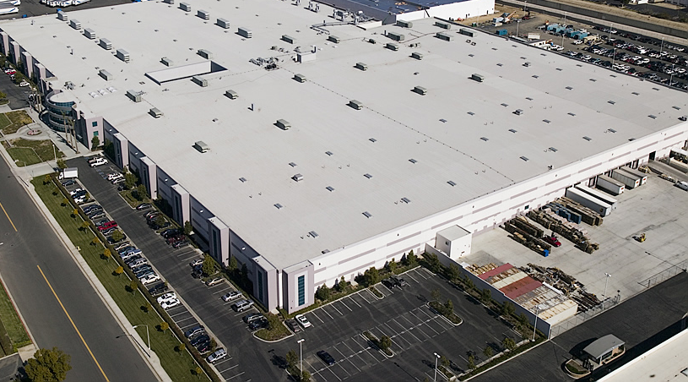
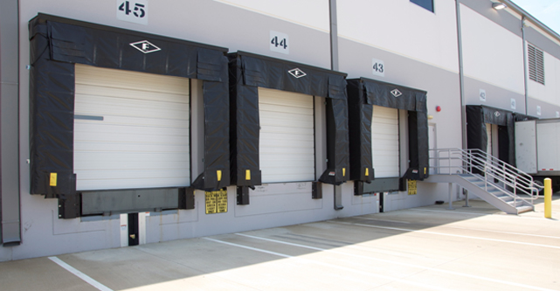
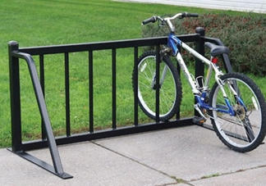
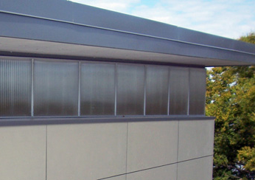
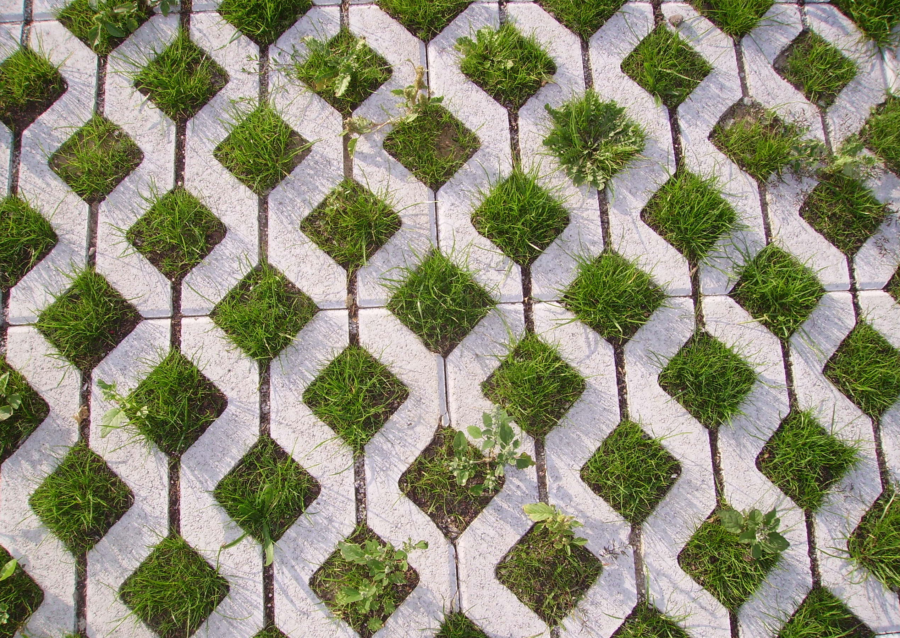
Balancing Building and Nature
Cool or reflective roofing systems
Dock door seals
Permeable paving and native landscaping
Bike racks and preferred carpool parking
Energy-efficient windows and overhangs
Notes:
Construction
Cool roof – For cooled spaces, consider a cool roof with a special coating that reflects solar radiation or a garden roof
Windows – Choose multiple pane windows with a U-value less than or equal to 0.3, low emittance coating and a low conduction gas fill
Dock seals – Use brush type seals for dock levelers and inflatable or foam-type hinge seals for dock doors – For best results, consider dock shelters which enclose the rear of the truck
Insulation – Verify insulation requirements for climate zone and operations – Insulate interior partition walls between semi-heated and conditioned spaces
Sealants – replace worn weather-stripping and caulking and air seal building seams and joints as well as utility penetrations
Use locally sourced or recycled content building materials
Outdoor
Bio-filtration system – Collect and move roof and parking lot runoff to where it can safely percolate back into the ground
Permeable paving – Reduce heat island effects and stormwater runoff by incorporating pervious paving materials, retention ponds, rain gardens and bioswales
Reduce paving around facility to reduce solar reflection and landscape to provide shading both for building and paved areas
Outdoor lighting – Utilize downward directional lighting to minimize off-site light trespass and protect nocturnal ecosystems
Landscaping – Plant native perennials and low water trees and shrubs to reduce water use
Provide secure bike racks and preferred parking for carpoolers to reduce automobile use

Slide 16
Operations
MHE – Incorporate energy efficient material handling systems such as “lights out” AS/RS or Motor Driven Rollers (MDR)
Recycling program – Introduce/expand a planned recycling program into the operating model to reduce trash
Mobile equipment – opportunity charging
– fuel cell powered forklifts

Slide 17
Labor

Slide 18
Leverage Your Most Important Asset –
Your Associates
Acquiring and retaining top performing employees is one of the largest factors in cost savings and risk mitigation.
115-120%
85-100%
70-75%
65-70%
Historic performance
Best
Practices
Labor Mgt.
System
Pay for Performance
Typical ROI is less than 1 Year

Slide 19
Best Practices
Supply Chain Efficiency & Service
Vendors
Customers
Your Company
Methods/processes
People
Information Systems
Continuous Improvement

Slide 20
Look Outside Your Four Walls
What are your supplier back charges costing?
Are customers asking more of you?
What if you asked more of your suppliers?
Be proactive – Ask your customers how you can be a better partner.

Slide 21
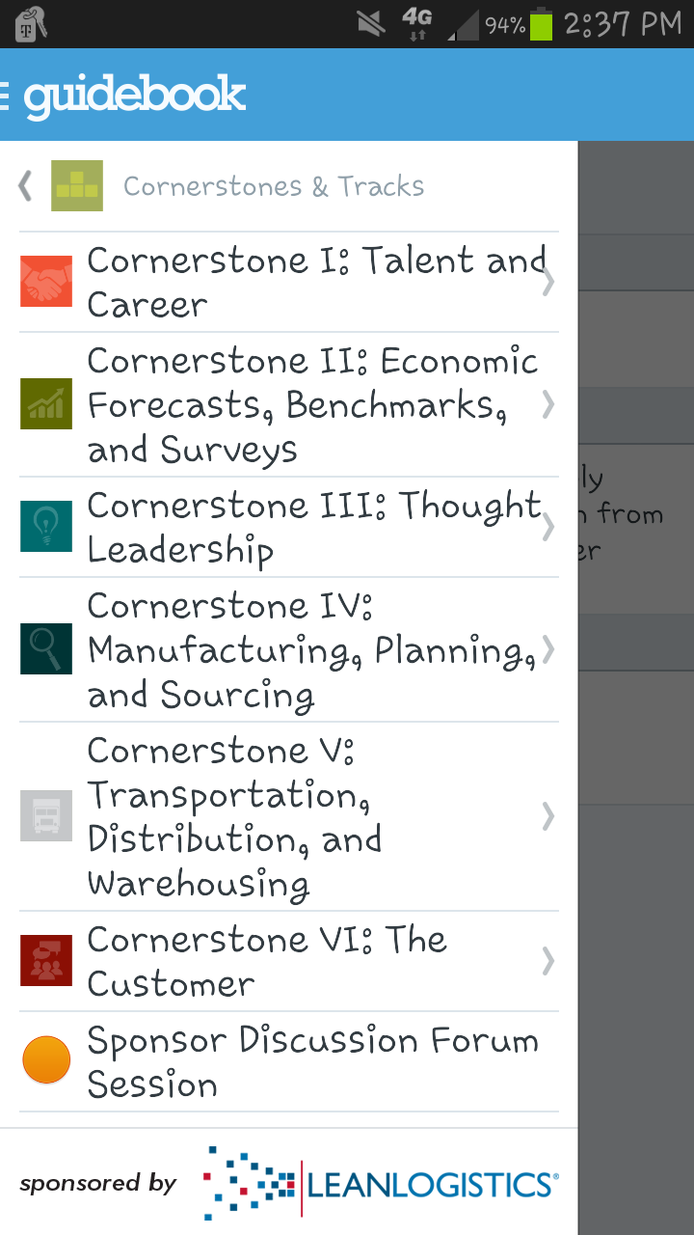
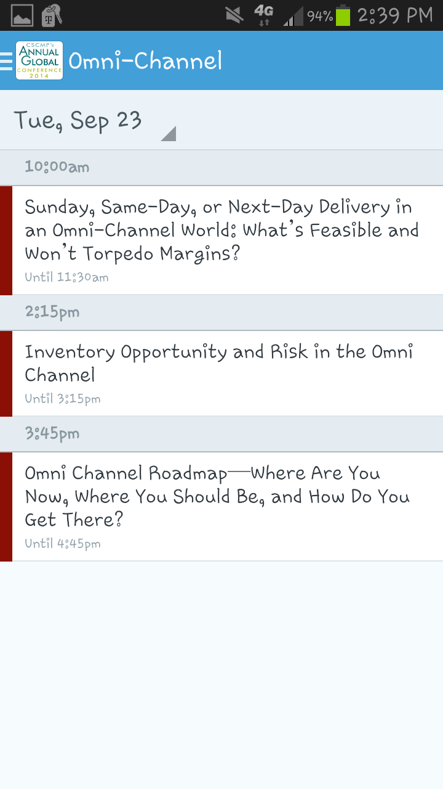
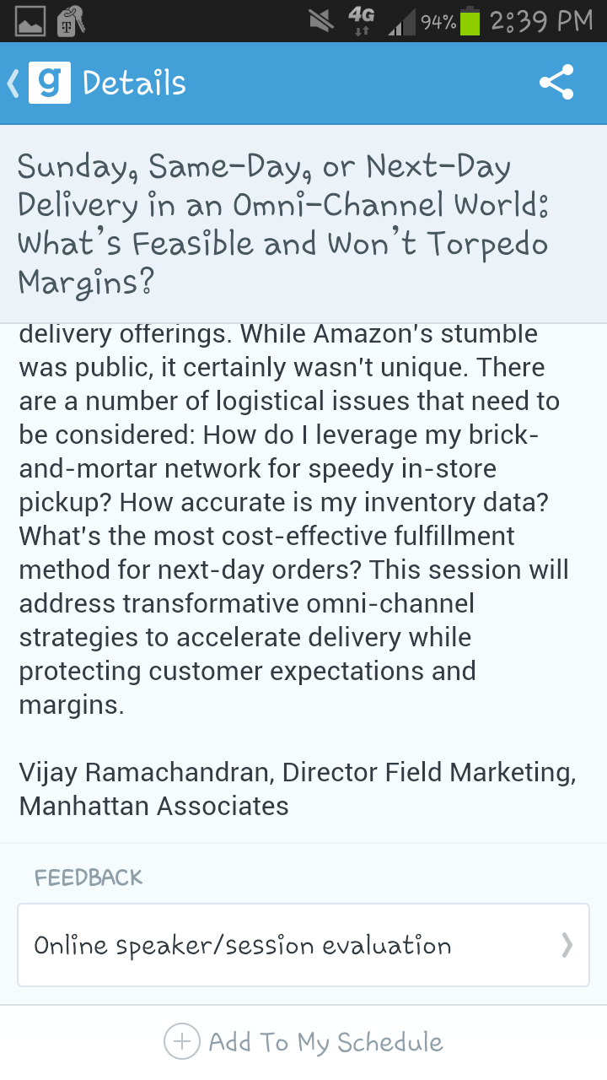
Don’t Forget to Complete the Evaluation!
Download the conference app and rate this session.
Start by choosing: “Cornerstones and Tracks” on the main menu and follow the prompts to this session’s landing page.

